Slide 1
Serious Injury/Illness Case(SIIC)
KPI | Green | Yellow | Red
SIIC | < 0.079 | > 0.079 and < 0.091 | > 0.091
Month | No of Case | Total Cont. MP | Total Comp MP | Total MP | Avg. for 26 days | Number of Hours Worked | LWDC | YTD
Apr-16 | 0 | 3417 | 2815 | 6232 | 240 | 46080 | 0 | 0.0
May-16 | 0 | 3341 | 1981 | 5322 | 205 | 39360 | 0
Jun-16 | 0 | 3455 | 2714 | 6169 | 237 | 45504 | 0
Jul-16 | 0 | 3495 | 2973 | 6468 | 249 | 47808 | 0
Aug-16 | 0 | 4137 | 2723 | 6860 | 264 | 50688 | 0
Sep-16 | 0 | 3698 | 2406 | 6104 | 235 | 45120 | 0
Oct-16 | 0 | 2633 | 2639 | 5272 | 203 | 38976 | 0
Nov-16 | 0 | 3386 | 2370 | 5756 | 221 | 42432 | 0
Dec-16 | 0 | 3915 | 2724 | 6639 | 255 | 48960 | 0
Jan-17 | 0 | 4154 | 2482 | 6636 | 255 | 48960
Feb-17 | 0 | 5080 | 3505 | 8585 | 330 | 63360 | 0
Mar-17 | 0 | 5193 | 2445 | 7638 | 294 | 56448 | 0
Total | 0 | 45904 | 31777 | 77681 | 2988 | 573696 | 0 | 0

Slide 2
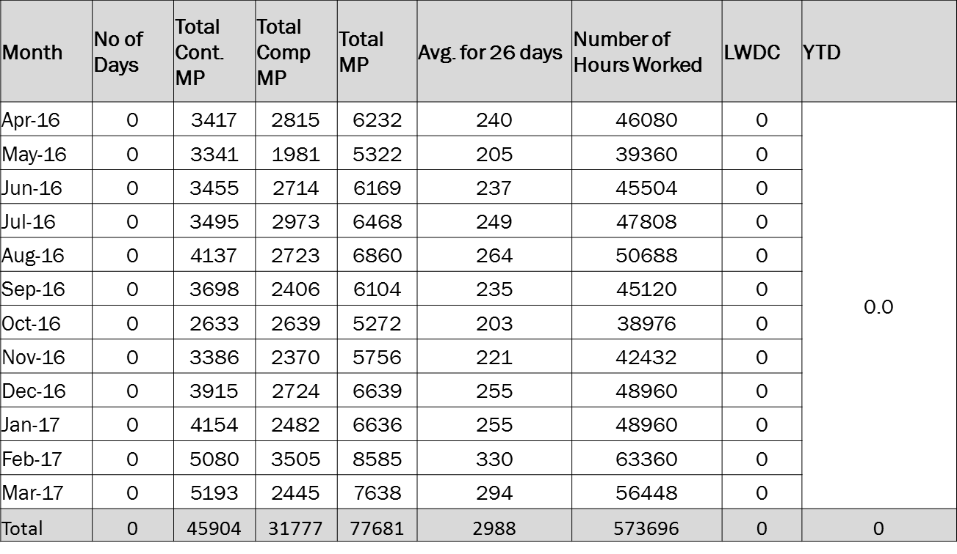
Lost Work Day Case (LWDC)

